Slide 1
Programming Basics
Vivify Academy

Slide 2
Functions

Slide 3
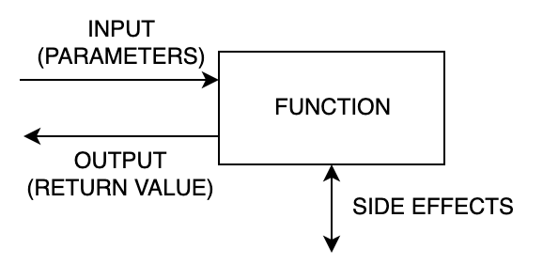
What is a function?
A function is a piece of code, also known as a “named procedure”, used by programming languages to group functionality that needs to be used in multiple places. Functions help reduce repetition and thus make code more maintainable. They can also make code more readable and understandable (if they are meaningfully named) by grouping related functionality.
A function takes any number of input values (parameters), does some processing and then returns a single value.

Slide 4
Creating a function
The declaration of a user-defined function start with the keyword function, followed by the name of the function you want to create, followed by parentheses () and finally place your function's code between curly braces {}.
Valid function names follow the same rules as for variables. A function name must start with a letter or underscore character, not with a number, optionally followed by more letters, numbers, or underscore characters.
// Defining a function
function printGreeting() {
console.log('Hello!');
}
// Calling a function
pringGreeting();

Slide 5
Functions with parameters
You can specify parameters when you define your function to accept input values at run time. The parameters work like placeholder variables within a function; when calling the function, they're replaced by the values (known as arguments) provided to the function.
You can define as many parameters as you like. However for each parameter you specify, a corresponding argument needs to be passed to the function when it is called.
// Defining a function function printSum(num1, num2) { var sum = num1 + num2;
console.log('Sum of numbers', num1, 'and', num2, 'is', sum); } // Calling a function printSum(10, 20);

Slide 6
Function parameters vs arguments
An argument is a value that you pass to a function, and a parameter is the variable within the function that receives the argument. In common usage these terms are often used interchangeably, but it’s important to know the difference.

Slide 7
Functions returning a value
// Defining a function
function getSum(num1, num2) {
var sum = num1 + num2;
return sum;
}
// Assigning the returned value
var sum = getSum(15, 10);
console.log(sum);
// Printing the returned value
console.log(getSum(5, 10));
A function can return a value using the return statement followed by a value. Keyword return stops the execution of the function immediately and sends the value back to where the function was called. This makes a function call an expression. If a function doesn’t return a value, its return value is implicitly undefined. This example takes two number parameters and add them together and then returns their sum to the calling program. Note that return keyword is used to return a value from a function. After the function ends, the function call is “replaced” with the value that the function returned (in this example, getSum(15, 10) is replaced with the value 25.

Slide 8
Variable scope
// Defining a function
function getSum(num1, num2) {
// This `sum` exists only in function
var sum = num1 + num2;
return sum;
}
// This `sum` is a distinct variable
var sum = getSum(15, 10);
console.log(sum);
// This causes an error:
console.log(num1);
A very important concept in programming is variable scope. Not all variables are visible in the entire program; for example, num1 and num2 are valid only inside the function, and trying to access them from outside will cause an error. In fact, they stop existing once the function ends; they are created when it’s called, and removed when the function returns.
Also, if we have multiple variables with the same name in different scopes, they are separate variables regardless of their names. In our example, we have two separate variables called sum - one inside the function and one outside.

Slide 9
Variable scope
var euroExchangeRate = 117.5388;
function exchange(euroAmount) {
return euroAmount * euroExchangeRate;
}
// "shadowing" an outside variable
function exchange(euroAmount) {
var euroExchangeRate = 118;
return euroAmount * euroExchangeRate;
}
On the other hand, variables declared outside a function are still visible inside, as long as we don’t create a separate variable with the same name inside. If we do that, we “shadow” the outside variable and we can’t access it anymore.

Slide 10
Variable scope
var sum = 0;
function sumNaturalNumbers() {
for (var i = 1; i <= 100; i++) {
sum += i;
}
}
sumNaturalNumbers();
console.log(sum);
// Second time:
sumNaturalNumbers();
console.log(sum);
Variables declared outside a function are accessible inside for writing as well - we can change a variable from inside any function, as long as it’s visible.

